Slide 1
Supervised and Unsupervised Machine Learning Model
Tomson George (C0857730)
Praveen Mahaulpatha (C0860583)
R. B. C. M. W. Thulana Vimukthi Abeywardana (C0861333)
AML 1413 – Introduction to Artificial Intelligence
Debashish Roy

Slide 2
Outline
Supervised Machine Learning Model
Unsupervised Machine Learning Model

Slide 3
Supervised Machine Learning Model

Slide 4
Supervised Machine Learning Models and Algorithms
Nearest Neighbor
Naive Bayes
Decision Trees
Linear Regression
Support Vector Machines (SVM)
Neural Networks

Slide 5

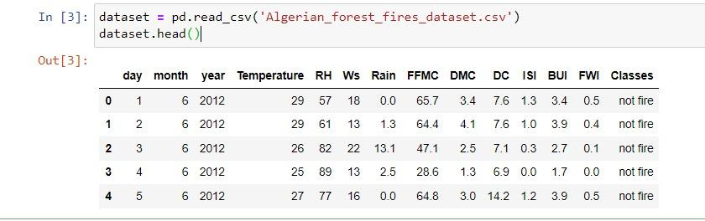
Dataset of Forest Fires in Algeria
Data from June 2012 to September 2012

Slide 6
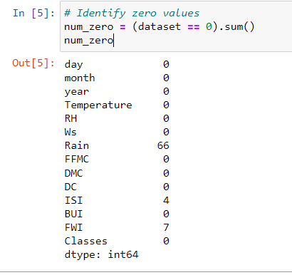
Data Preparation
Identifying zero values
In this dataset, zero values are accepted for those features. Hence they are not to be replaced with NaN.

Slide 7
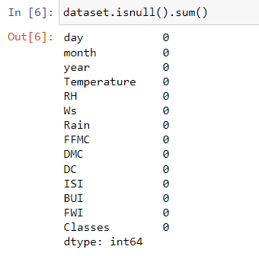
Check for Null values
Null values were not observed.

Slide 8
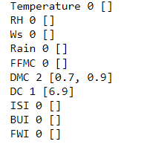
Outlier detection
Values close to outliers are observed, but they are laid near to the boundary values (DMC: 1.1 to 65.9, DC: 7 to 220.4). Hence they are not removed from the dataset.

Slide 9
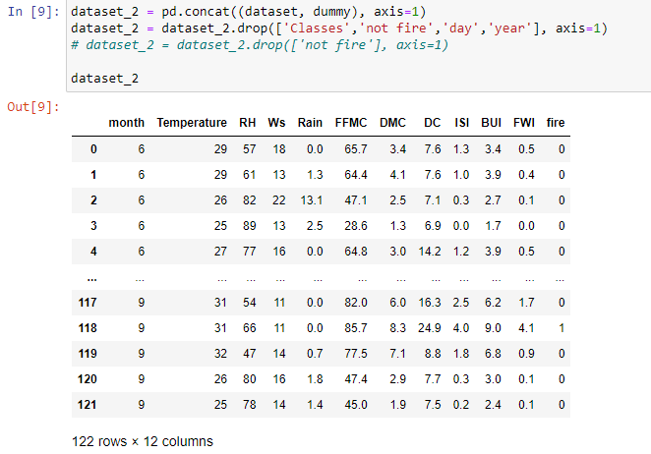
Label encoding
Class column is dropped and its corresponding label encoded column is added.

Slide 10
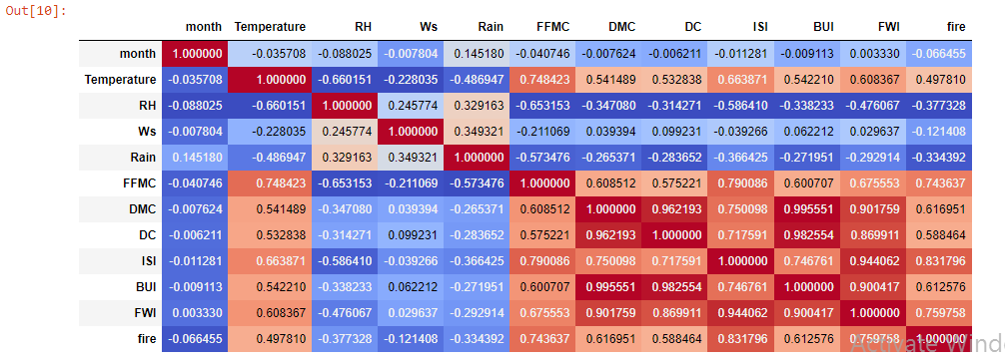
Correlation
Poor correlation in month.

Slide 11
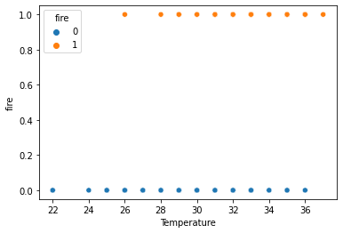
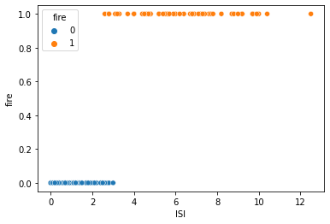
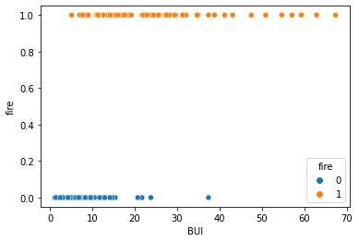
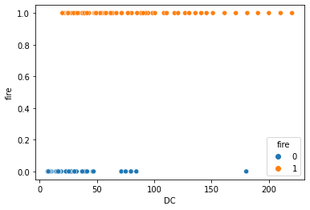
Data plot

Slide 12
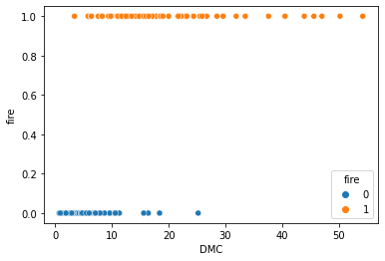
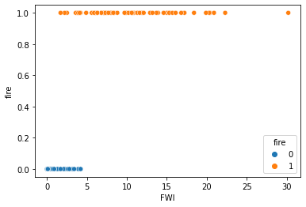
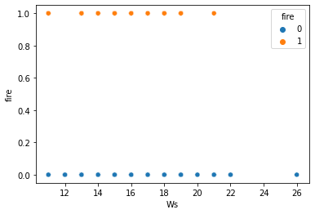
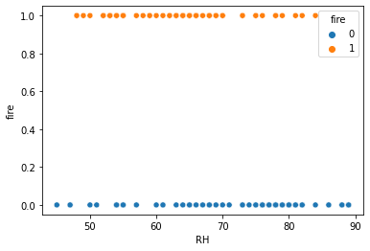

Slide 13
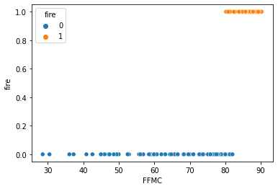
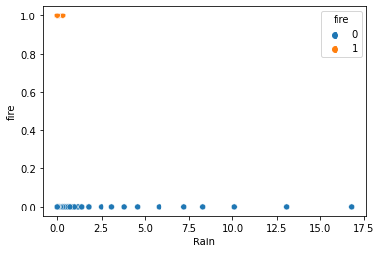

Slide 14
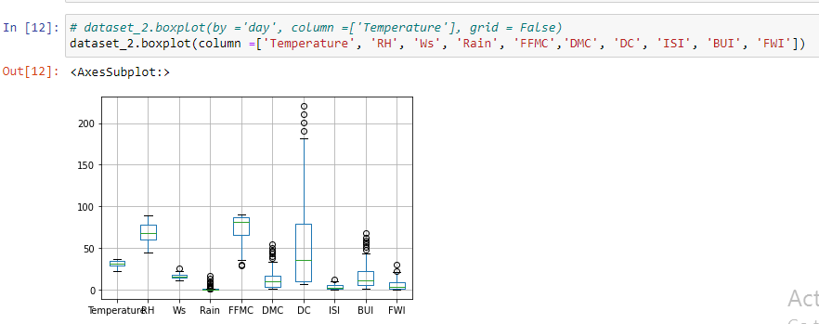
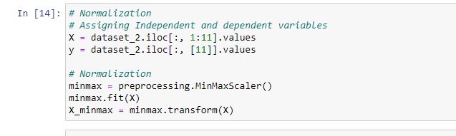
Normalization
Spreading of the data can be visualized as follows

Slide 15


Model Training, Testing and Validation
Splitting the dataset
Dataset is spited in to two subsets randomly (Training: 80%, Testing 20%)
Training, Testing and Validation
Logistic regression model is used, since it’s a binary classification case.

Slide 16
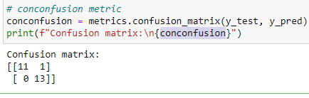
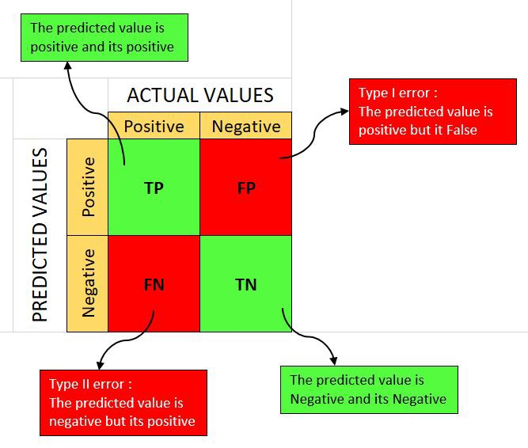

Accuracy is calculated using Confusion Matrix
Accuracy = (TP + TN) / (TP + TN + FP + FN)

Slide 17




Precision = TP / (TP + FP)
Recall = TP / (TP + FN)
F1 score = 2 * Precision * Recall / (Precision + Recall)
Mean Squared Error

Slide 18
Unsupervised Learning

Slide 19
Unsupervised Models and Algorithms
Clustering
K-Means;
Hierarchical Clustering and Spectral Clustering;
DBSCAN and OPTICS;
Dimensionality reduction
Principal Component Analysis;
Manifold Learning — LLE, Isomap, t-SNE;
Autoencoders
Anomaly Detection
Isolation Forest;
Local Outlier Factor;
Minimum Covariance Determinant

Slide 20
Dataset of Customers of A Shopping Mall
Features are,
Customer ID
Age
Gender
Annual Income
Spending Score (1-100)

Slide 21
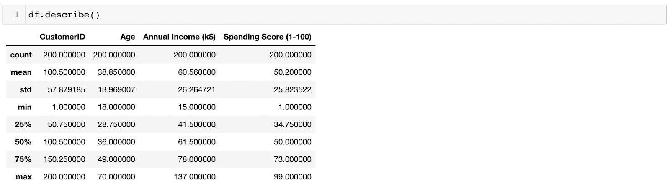
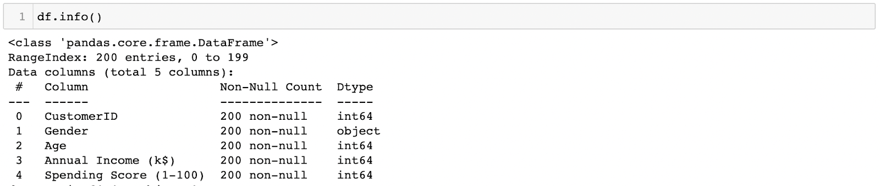
Exploratory Data Analysis
Descriptive statistics

Slide 22
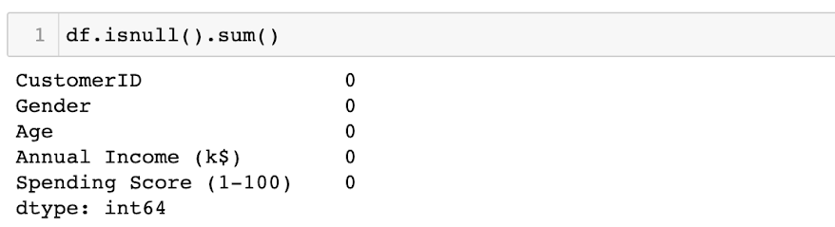
Checking for null values

Slide 23
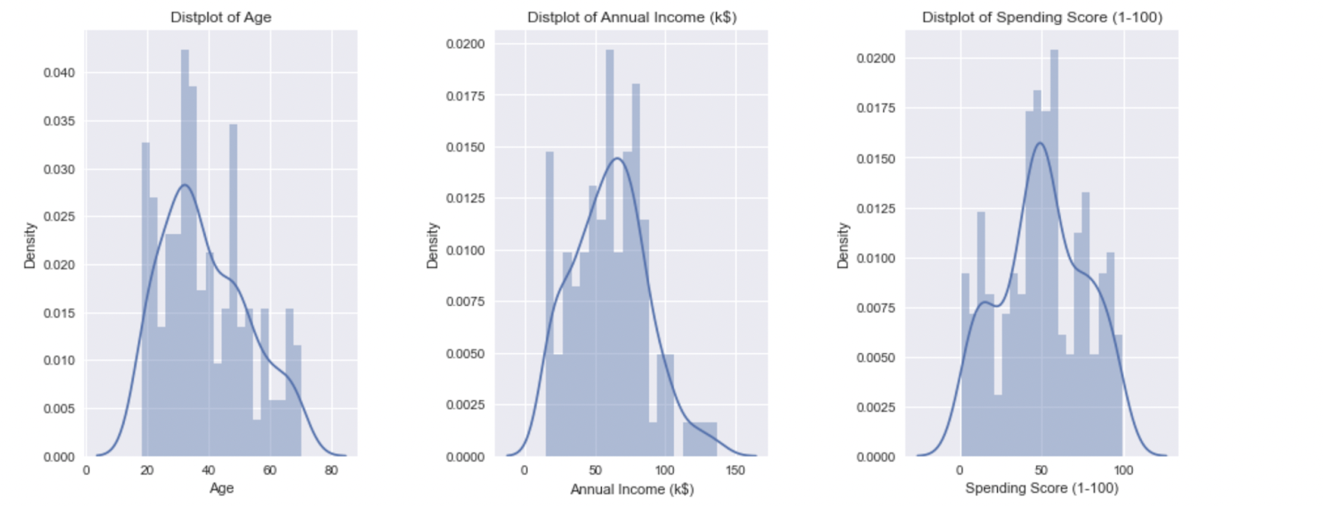
Plotting Histograms
Data seems to be having a normally distributed but slight skewness can be identified. The ranges of axis among the labels are having similar values hence normalization will not be necessary.

Slide 24
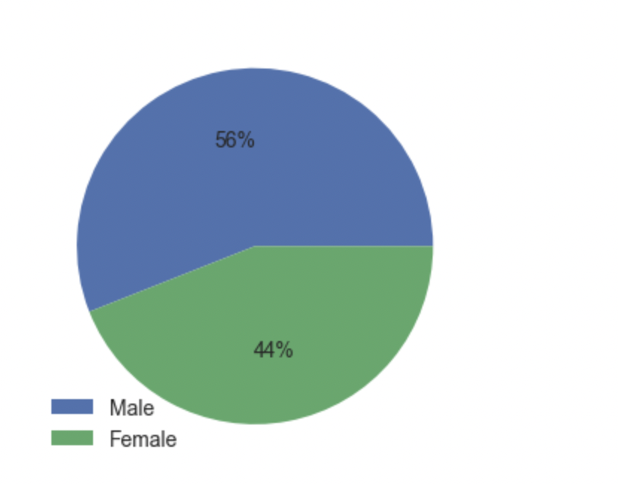
Plotting Pie Chart
Data seems to be more biased towards Male population hence we can draw a better sample in the next phase of the project.

Slide 25
Fitting the Model
K means clustering algorithm used to find out hidden clusters among datasets
The key is to find out the best value for variable k, in order to yield the most efficient results

Slide 26
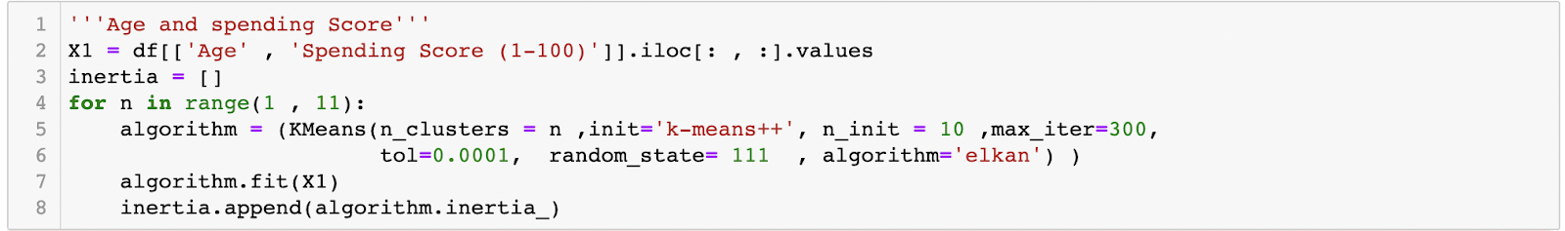
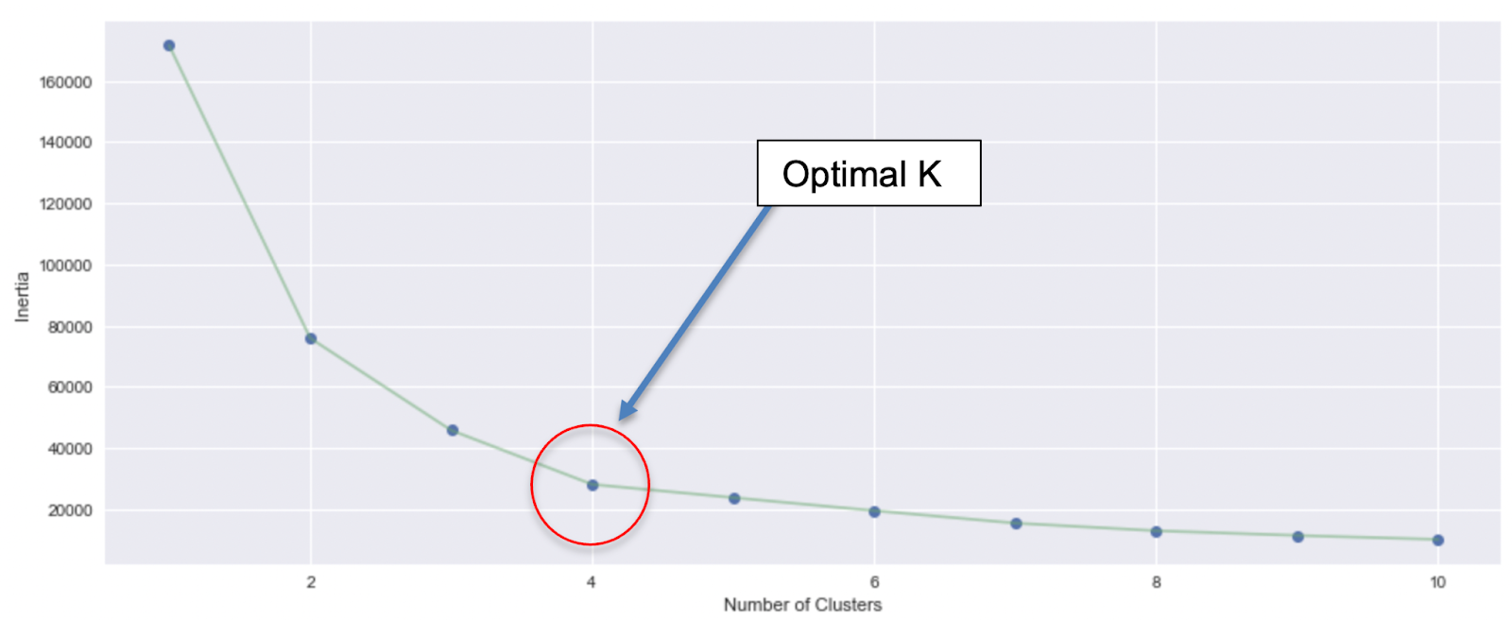
Finding the Optimal K value
Finding out the Inertia
Inertia measures how well a dataset was clustered by K-Means.
Elbow method is used : k value where the decrease in inertia begins to slow as the optimal k value

Slide 27
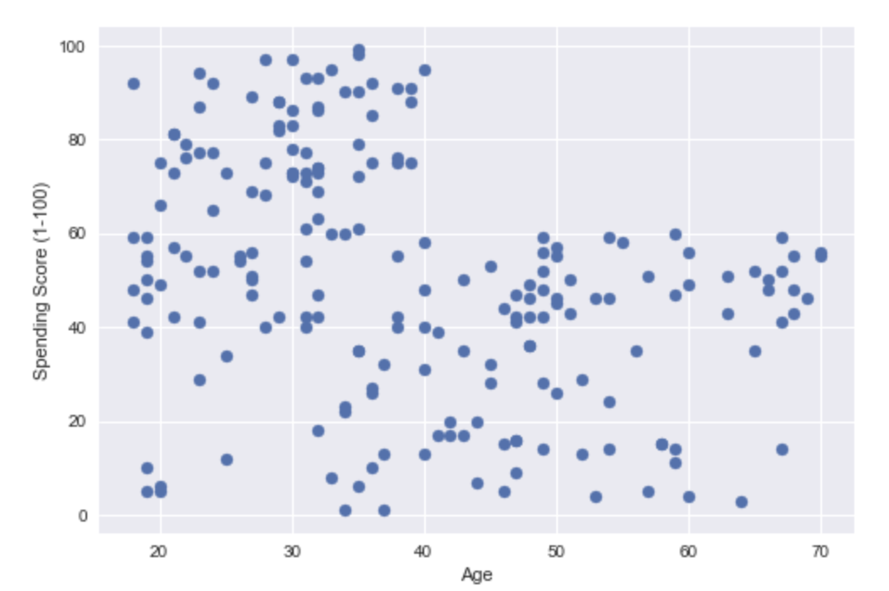
Scatter plot before model fit
Some clusters seems to be existing

Slide 28
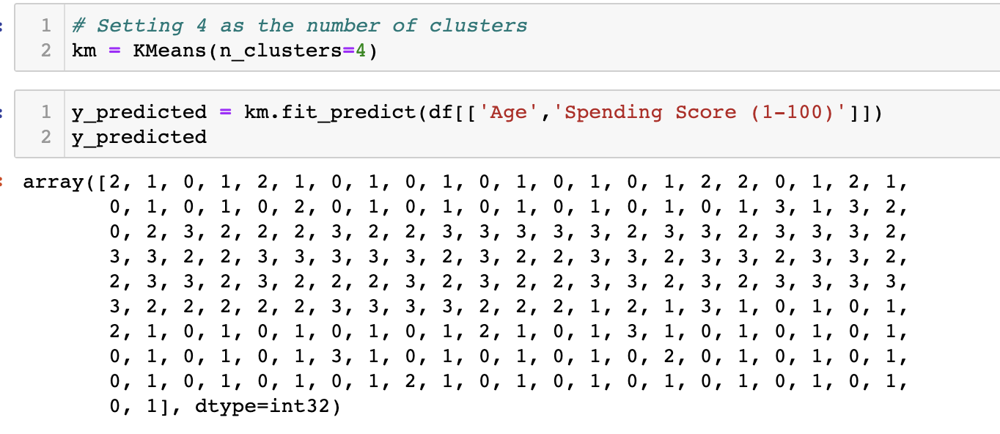
Fitting the K means Algorithm

Slide 29
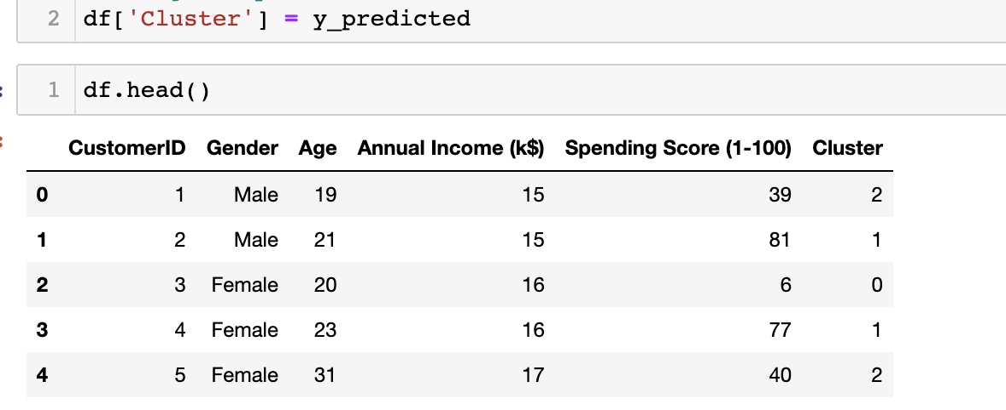
Appending to the dataframe

Slide 30
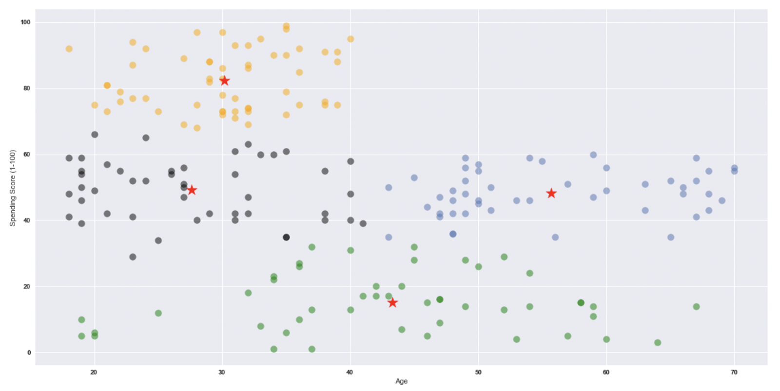
Fitting K Mean

Slide 31
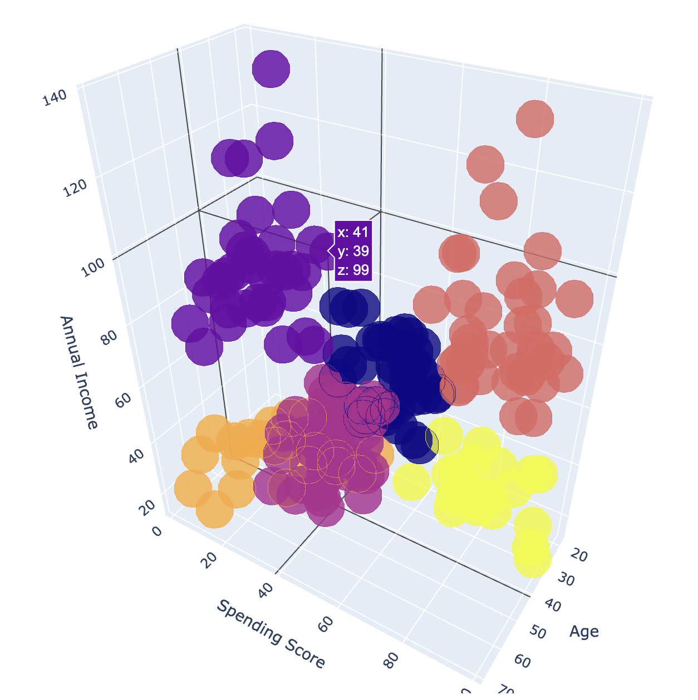
3D Scatter plot for all 3 Features
plotly.graph_objs
Enables focused Marketing

Slide 32
Thank you

